Slide 1
Lecture 1
SVD and PCA

Slide 2
SVD
A form of matrix decomposition (factorization into a product of matrices)
Other forms of matrix decomposition (Eigendecomposition, LU factorization/reduction--should be familiar from Math 54)
In singular value decomposition, the matrix can be written as a sum of rank-1 matrices
A = σ1u1vT1 + σ2u2vT2 + . . . + σnunvT (format later)
Each one of these matrices is a mode.
σ values: the singular values are square roots of eigenvalues from AA^{T} or A^{T}A.

Slide 3
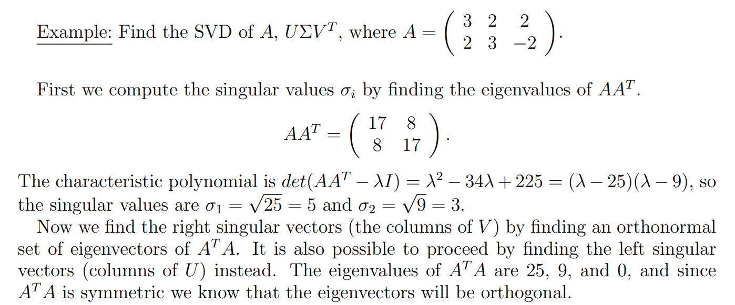
Numerical Example

Slide 4
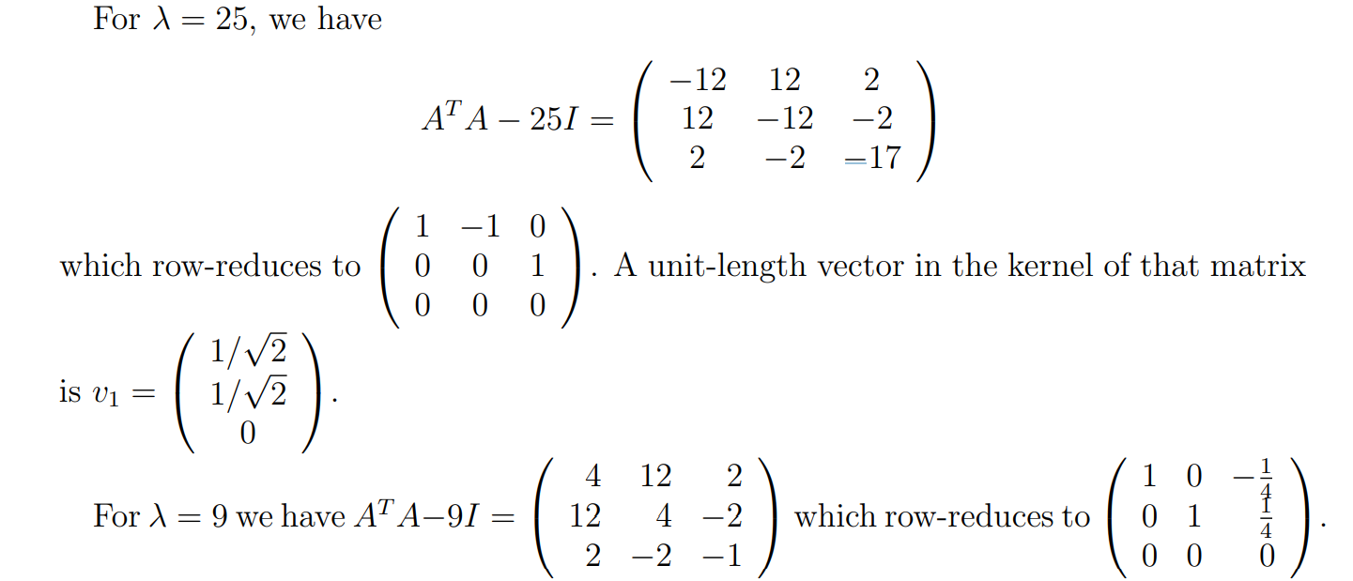

Slide 5
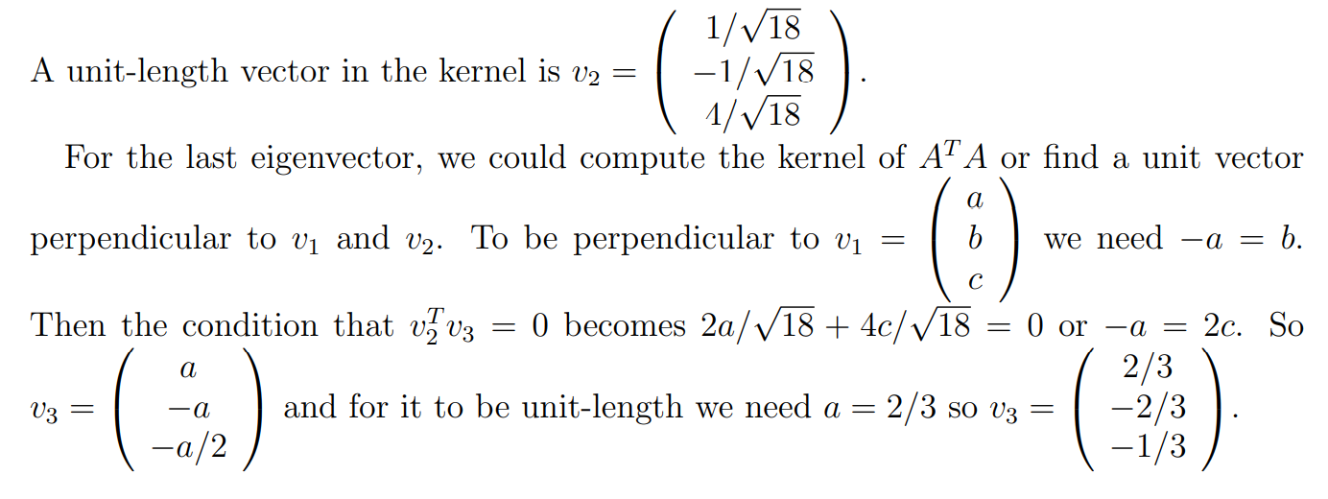

Slide 6
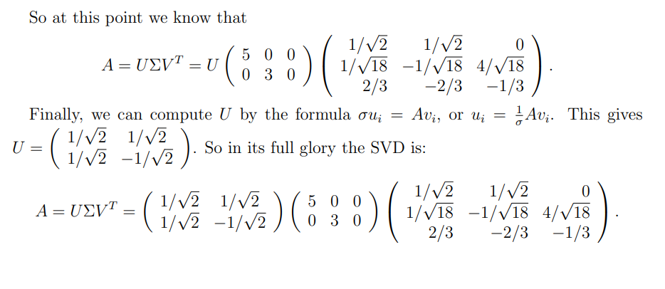

Slide 7
Applications
Some applications of the SVD:
Computing the pseudoinverse of a matrix
matrix approximation
determining the rank, range and null space of a matrix.
separable models.
nearest orthogonal matrix.
Kabsch algorithm (calculating the optimal rotation matrix that minimizes the root mean squared deviation between two paired sets of points)

Slide 8
PCA
dimensionality-reduction method: for analysis, it is often necessary to reduce the dimensionality of large data sets
transforming a large set of variables into a smaller one that still contains most of the information in the large set.
small loss of accuracy, but the aim is to achieve a simpler dataset by preserving as much information as possible.
Steps: standardization, covariance matrix computation, and identify principal components by computing the eigenvalues of the covariance matrix.
For standardization: subtract the mean and divide by the standard deviation for each value of each variable.

Slide 9


Standardization and computing the covariance matrix

Slide 10
Applications
Some applications of PCA:
Computing the pseudoinverse of a matrix
dimensionality reduction
multivariate analysis. E
data compression
image processing
Visualization
exploratory data analysis,
pattern recognition and time series prediction.

